Slide 1
Data Science Pipelines (Preview)

Slide 2
Employing Machine Learning
In this class you will learn to use ML to analyze, model, and develop results using data
But in the real world we have a problem/opportunity and want to make a decision
How do we use ML to help?
There are some tasks needed to support ML:
Defining a problem
Collecting data
Conducting preliminary data analysis
Interpreting and acting on results
1 https://www.forbes.com/sites/gilpress/2013/05/28/a-very-short-history-of-data-science/?sh=5d1d52fc55cf
2 http://www.jds-online.com/about

Slide 3
Data Science Pipelines
Data Science¹ is a larger field which includes ML and other activities designed to support it and use its results
Includes collecting, analyzing, modeling data²
The activities are constructed in sequences or pipelines
Multiple names for these
Data Analysis
Knowledge Discovery in Databases (KDD), CRISP-DM
Data Mining (set of technique to conduct analysis)
In this class we will use Data Science Trajectories (DST)
1 https://www.forbes.com/sites/gilpress/2013/05/28/a-very-short-history-of-data-science/?sh=5d1d52fc55cf
2 http://www.jds-online.com/about

Slide 4
Task for next class (ungraded)
Read the data science trajectory paper
Using the DST building blocks, create a DST for your AFIT research
If you don’t have a machine learning research project, then make one up that is close to your AFIT research

Slide 5
Data Problem Description
<insert your description here>
<insert project name here>
Instructions (remove after you build your diagram)
We recommend creating your DST on paper first, then using this power point template to create an elegant electronic version
Copy the elements below and use them to create your own data science trajectory following the guidance from the course reading, Martinez-Plumed, et al. Use the description box to the right to add your own description.
The number text boxes are fairly small and difficult to work with. The best way we’ve found is to move the cursor close to the number until the move icon appears, then click and drag. If you click and then attempt to click and drag, too often the move cursor changes to a resize cursor.
Data Acquisition
Data Source Exploration
1
2
Product Exploration
0
Data
Preparation
3
Modeling
4
5
Data Simulation
1
2
0
1
2
3
4
5
6
7
8
9
10
11
12
13
14
15
16
17
18
19
20
Business Understanding
Data
Understanding
Data
Preparation
Modeling
Evaluation
Deployment
Data Acquisition
Data Simulation
Goal Exploration
Data Source Exploration
Data Value Exploration
Result Exploration
Narrative Exploration
Product Exploration
Data Architecting
Data Release

Slide 6
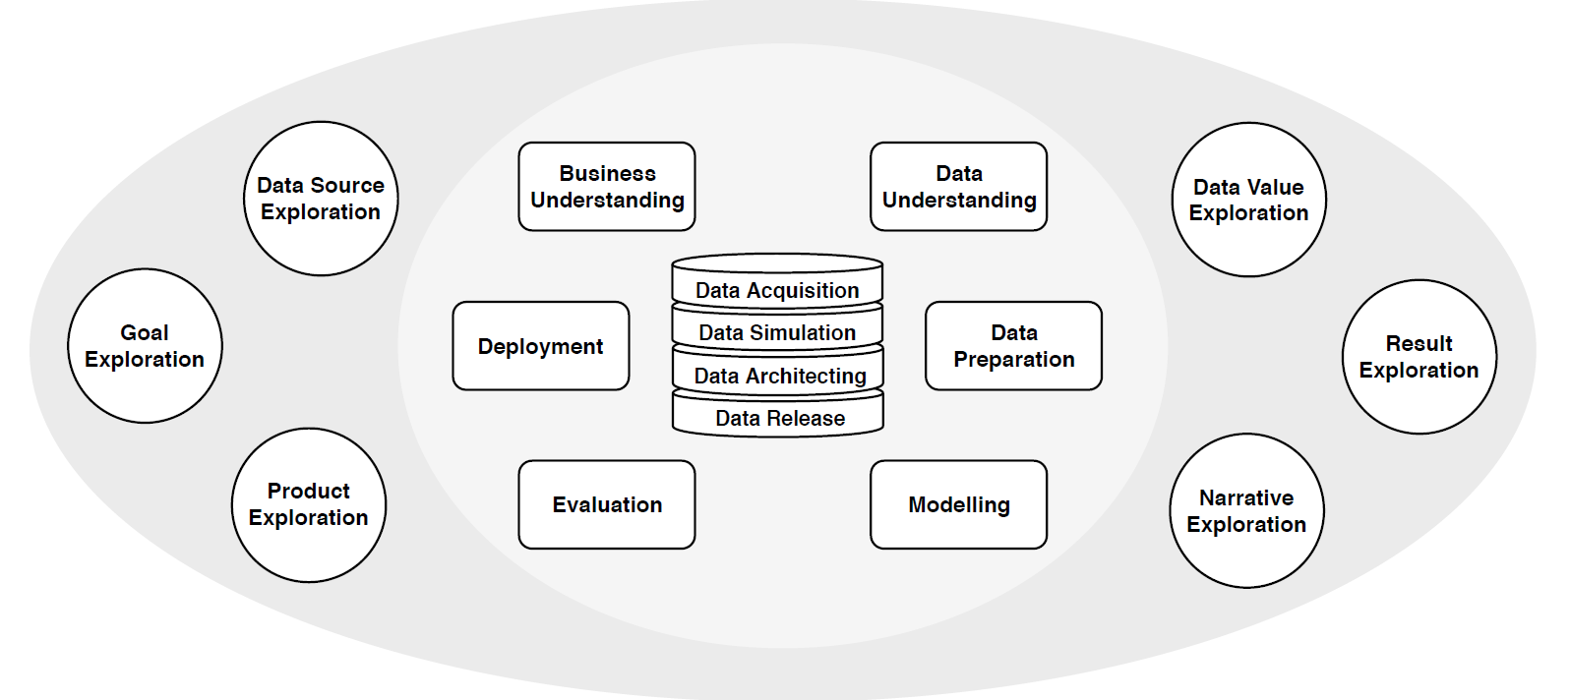
Draw your trajectory through the diagram
Notes:
Data Science Trajectories – you’ll be introduced to a set of tasks that are conducted in data science.

Slide 7
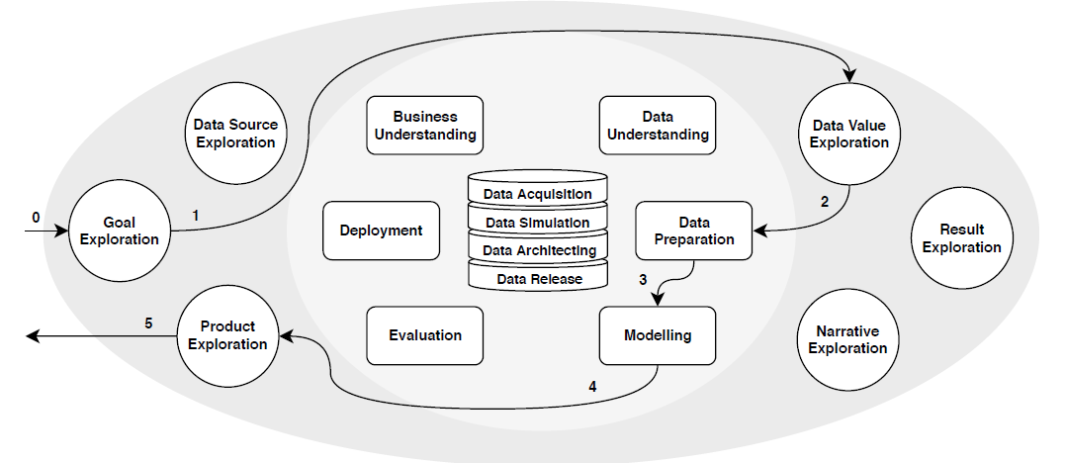
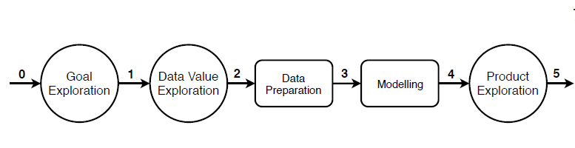
Procedure example:
Tourism Recommender (sec 4.1)
Draw trajectory
Start with template
Build trajectory diagram

